Slide 1

Stock Market Analysis and Prediction
Sowrab Sahini
Likita Chamakura
Prathyusha Daroor
Naga Srija Guntupalli
Sowrab Sahini
Likita Chamakura
Prathyusha Daroor
Naga Srija Guntupalli

Slide 2

OUTLINE
Introduction
Goals and Objectives
Dataset
Model Architecture
Workflow Diagram
Implementation
Results
References

Slide 3
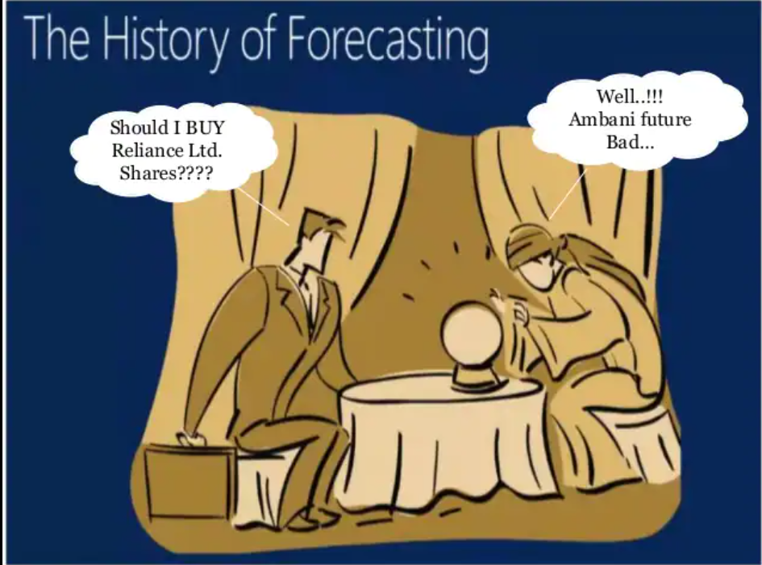

Slide 4
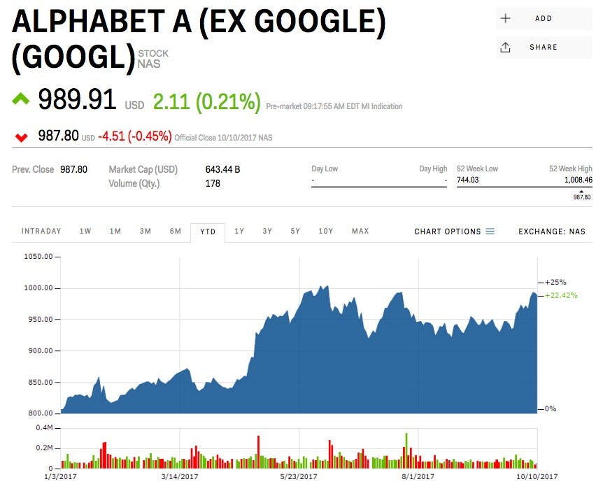
INTRODUCTION
In today's economy, the stock market, has a significant effect.
It is one of the most important sources for companies to raise money.
Predicting stock prices is a challenging task as it depends on various factors.
Analyzing the trend over the last few years could prove to be highly useful for making stock market movements.

Slide 5

INTRODUCTION contd..
Stock Prediction Methods:
Fundamental Analysis(Positive/Negative)
Technical Analysis(Plotting)
Technological Methods used:
Random Forest(RF)classification Algorithm
Linear Regression(LR)
- LSTM(Long short term memory)

Slide 6
GOALS AND OBJECTIVES
Motivation: To combine fundamental and technical analysis to analyze stock market data.
Significance: Useful to investors and traders to make better decisions.
Objectives: To improve stock market analysis using sentiment analysis, logistic regression, and Neural Networks.
Features: Given a stock market ticker of a company we will predict the stock prices and visualize the prices over time.

Slide 7
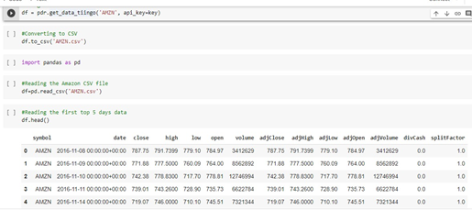
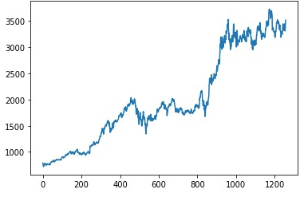
DATASET
TINGO API from panda’s data reader. This is used to get the historic data of the specified company using the API key.
In our project, we have used “Amazon” twitter data set.
Fig: Displaying the data
Fig: Visualizing the Data

Slide 8
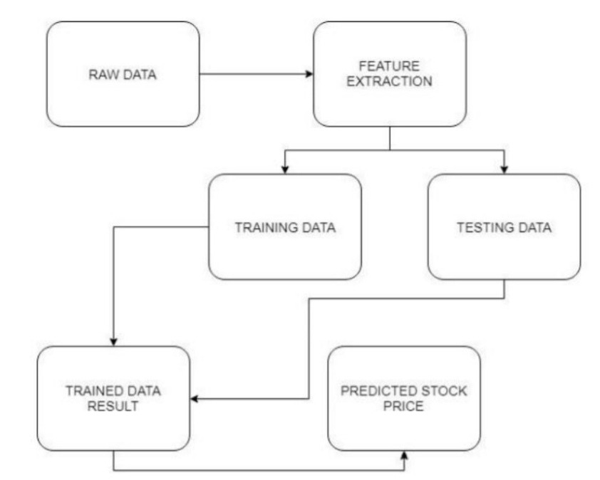
MODEL ARCHITECTURE

Slide 9
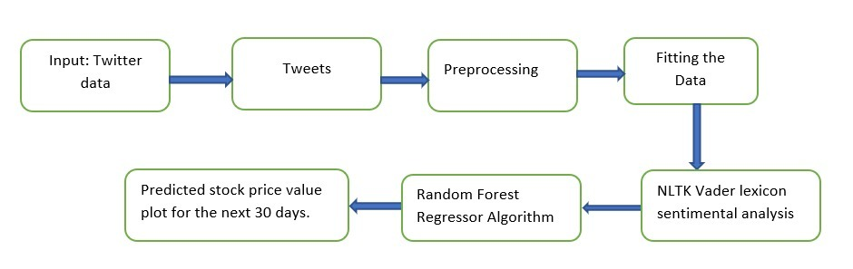
WORK FLOW DIAGRAM
Random Forest Regressor

Slide 10
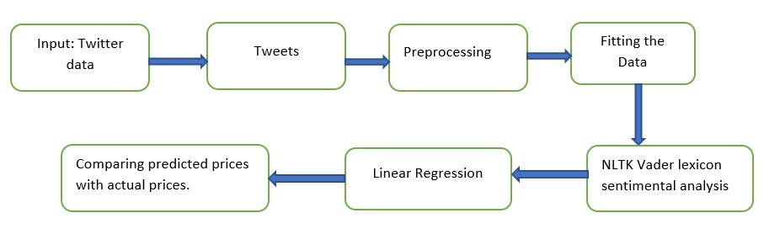
WORK FLOW DIAGRAM
Linear Regression

Slide 11
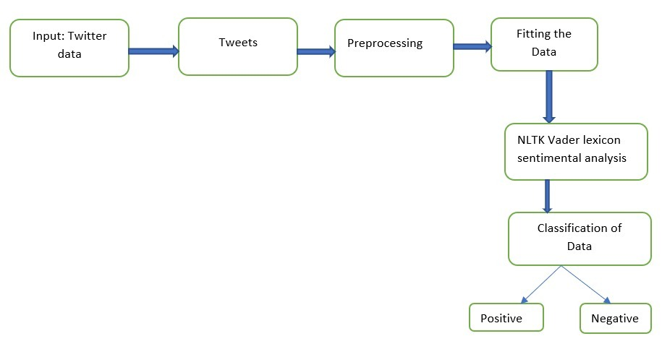
WORK FLOW DIAGRAM
Classification using Sentimental Analysis

Slide 12
IMPLEMENTATION
Taking Companies historic data from TIINGO API .
Dividing the dataset into two parts – training dataset and testing dataset.
Using LSTM to build the model and train the data.
Using NLTK’s vader lexicon sentimental analysis to classify the tweets as positive/negative.
Using Random Forest Regressor to predict the stock prices for the next 30 days.
Finally, Comparing the predicted prices with the actual price.

Slide 13
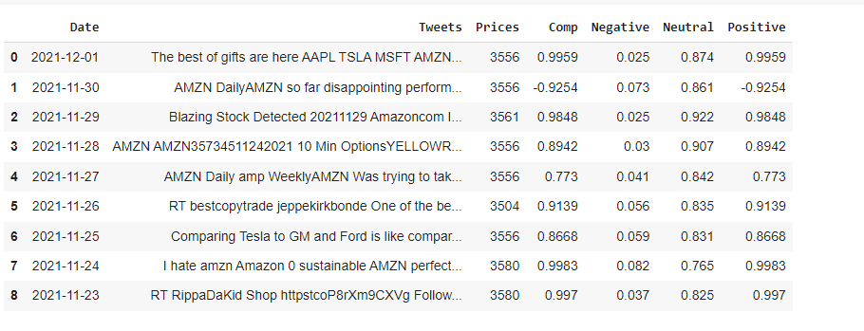
RESULTS
Classifying tweets as positive/negative by using NLTK’s vader lexicon sentiment analysis.

Slide 14
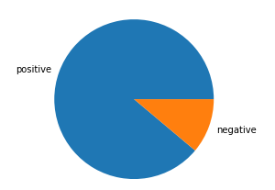
RESULTS
Pie chart representation showing classification results based on sentimental analysis

Slide 15
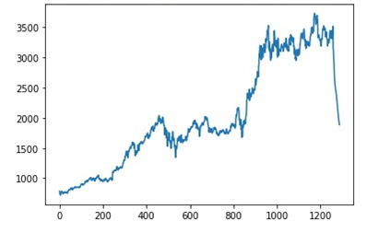
RESULTS
Predicted prices for the next 30 days using random forest generator algorithm.
Prediction for upcoming 30 days

Slide 16
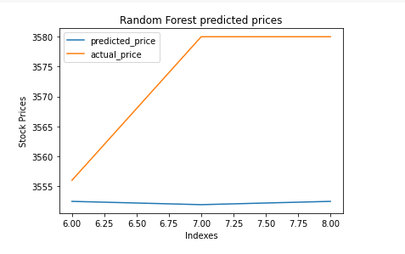
RESULTS
Comparison between actual_price and predicted price

Slide 17
REFERENCES
[1]M. Zu, "NLP for Stock market prediction with reddit data,“
https://web.stanford.edu/class/cs224n/reports/final_reports/report030.pdf.
[2]"U.S security and exchange commission," 9 jan 2017. [Online]. Available: https://www.sec.gov/edgar.shtml.
[3]"TIINGO," [Online]. Available: https://api.tiingo.com/documentation/general/overview.
[4]"Keras LSTM layer," [line]. Available: https://keras.io/api/layers/recurrent_layers/lstm/.
[5]Stock Closing Price Prediction using Machine Learning Techniques Mehar Vijha , Deeksha Chandolab, Vinay Anand Tikkiwalb, Arun Kumar

